Slide 1
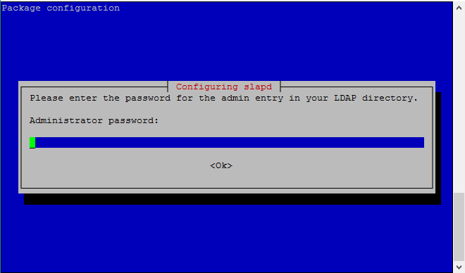
How to Install OpenLDAP
Sudo apt-get update
Sudo apt-get install slapd ldap-utils

Slide 2
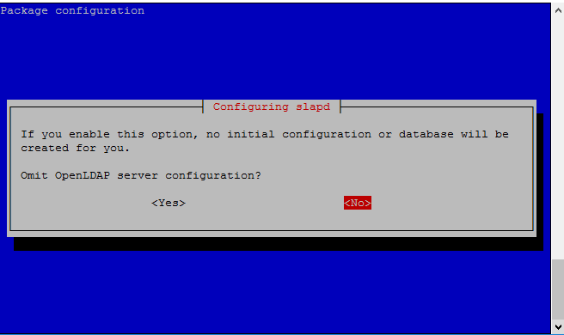
Reconfiguring OpenLDAP
Sudo dpkg-reconfigure slapd

Slide 3
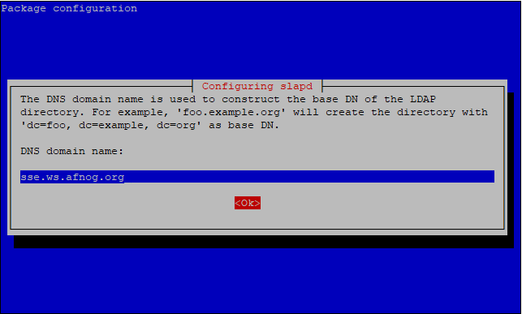
Reconfiguring OpenLDAP Continue

Slide 4
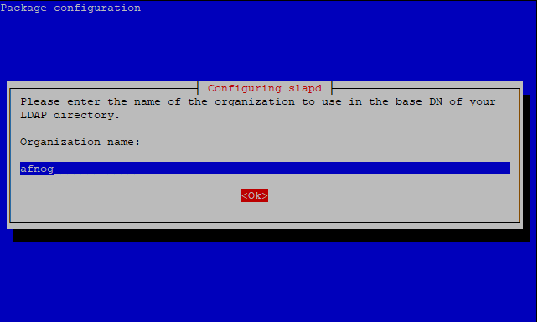
Reconfiguring OpenLDAP Continue

Slide 5
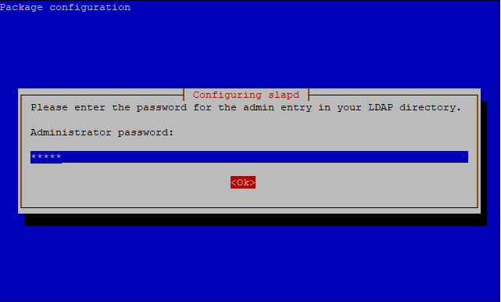
Reconfiguring OpenLDAP Continue

Slide 6
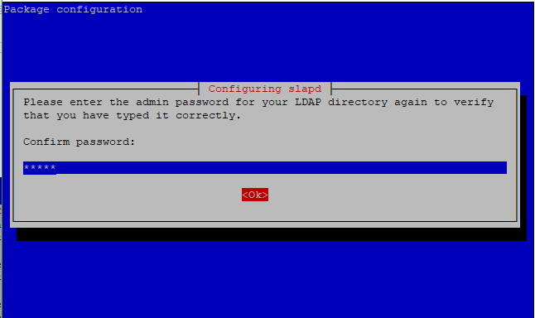
Reconfiguring OpenLDAP Continue

Slide 7
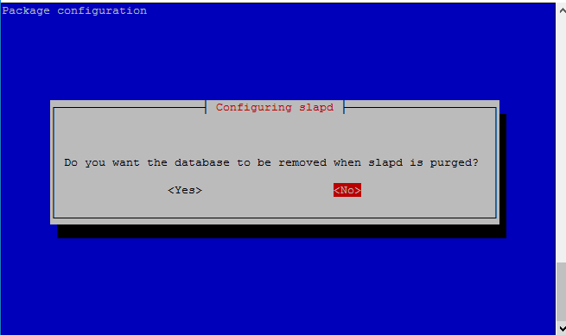
Reconfiguring OpenLDAP Continue

Slide 8
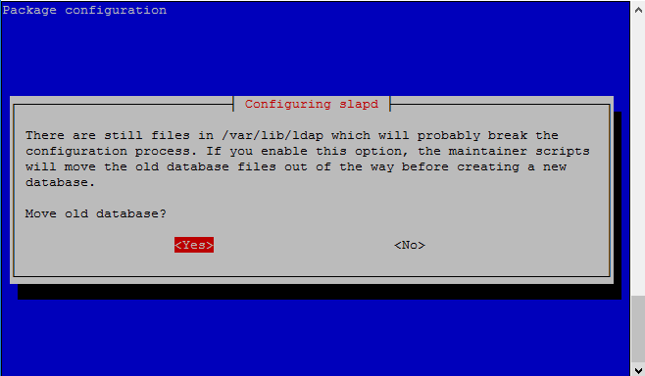
Reconfiguring OpenLDAP Continue

Slide 9
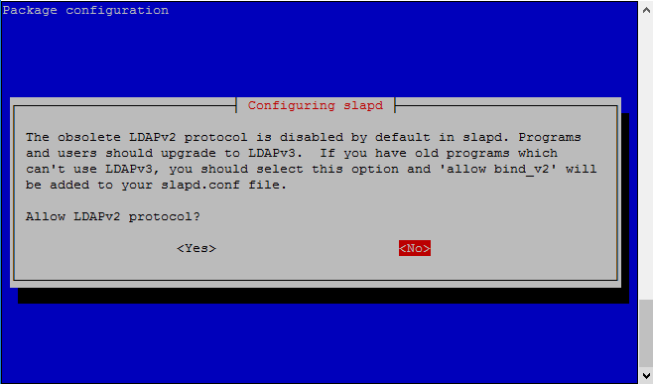
Reconfiguring OpenLDAP Continue

Slide 10

Reconfiguring OpenLDAP Continue
Start your Openldap Database and ensure It is working with commands as below.
sudo systemctl start slapd
sudo ps -ef | grep slapd

Slide 11
Creating a base Ldif file
Create a file with content below for your base directory structure.
Vi base.ldif
dn: ou=Groups,dc=sse,dc=ws,dc=afnog,dc=org
ou: Groups
objectClass: top
objectClass: organizationalUnit
dn: ou=Users,dc=sse,dc=ws,dc=afnog,dc=org
ou: Users
objectClass: top
objectClass: organizationalUnit

Slide 12
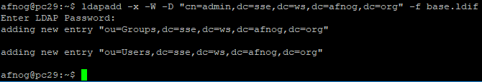
Upload your base LDIF file to LDAP
Run the command below to upload your base ldif file into the LDAP server
ldapadd -x -W -D "cn=admin,dc=sse,dc=ws,dc=afnog,dc=org" -f base.ldif
Supplied your LDAP password and you should see feedback as below

Slide 13
Creating a person Ldif file
Create a file with content below for your base directory structure.
Vi person.ldif
dn: cn=frank,ou=Groups,dc=sse,dc=ws,dc=afnog,dc=org
cn: frank
gidNumber: 5001
objectClass: posixGroup
dn: uid=frank,ou=Users,dc=sse,dc=ws,dc=afnog,dc=org
uid: frank
uidNumber: 5001
gidNumber: 5001
cn: Frank Kuse
sn: Kuse
objectClass: posixAccount
objectClass: organizationalPerson
loginShell: /bin/bash
homeDirectory: /home/frank

Slide 14
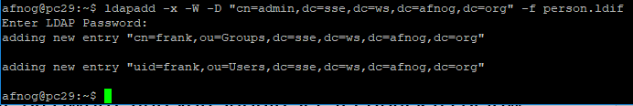
Upload your person LDIF file to LDAP
Run the command below to upload your base ldif file into the LDAP server
ldapadd -x -W -D "cn=admin,dc=sse,dc=ws,dc=afnog,dc=org" -f person.ldif
Supplied your LDAP password and you should see feedback as below

Slide 15
Setting up user credentials
Run the command below create a password for the user account created.
sudo ldappasswd -s afnog123 -W -D "cn=admin,dc=sse,dc=ws,dc=afnog,dc=org" -x "uid=frank,ou=Users,dc=sse,dc=ws,dc=afnog,dc=org"
Supplied your LDAP password and you should see feedback as below

Slide 16
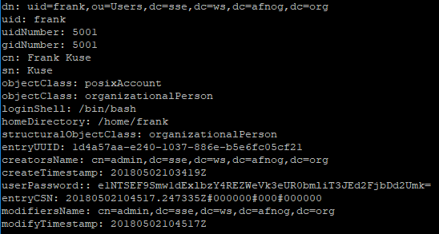
Check your LDAP directory structure
Run the command below to check your uploaded ldif files forming your LDAP directory structurein your database.
Sudo slapcat
You should see entire OpenLdap database with example as below.

